Slide 1


Chapter 5: Shortest Path Algorithms
Dr. Amine Ben Abdeljelil

Slide 2
Shortest Path Algorithms
Shortest path algorithms are a family of algorithms designed to solve the shortest path problem.
The shortest path problem is something most people have some intuitive familiarity with: given two points, A and B, what is the shortest path between them?
Shortest path algorithms have many applications. Mapping software like Google or Apple maps makes use of shortest path algorithms. They are also important for road network, operations, and logistics research. Shortest path algorithms are also very important for computer networks, like the Internet.
Any software that helps you choose a route uses some form of a shortest path algorithm. Google Maps, for instance, has you put in a starting point and an ending point and will solve the shortest path problem for you.

Slide 3
Shortest Path Algorithms
An edge-weighted digraph is a digraph where we associate weights or costs with each edge. A shortest path from vertex s to vertex t is a directed path from s to t with the property that no other such path has a lower weight.
Properties
Paths are directed: A shortest path must respect the direction of its edges.
The weights are not necessarily distances : the weights might represent time or cost.
If a vertex t is not reachable from a vertex s, there is no path at all, and therefore there is no shortest path from s to t.

Slide 4
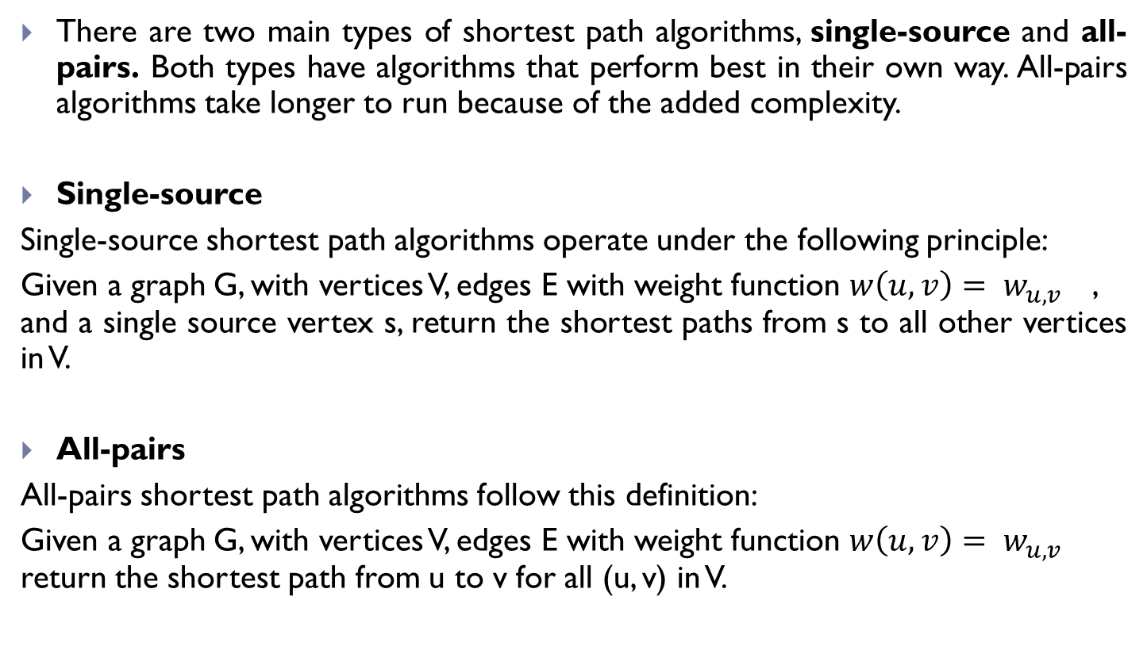
Types of Shortest Path Algorithms
There are two main types of shortest path algorithms, single-source and all-pairs. Both types have algorithms that perform best in their own way. All-pairs algorithms take longer to run because of the added complexity.
Single-source
Single-source shortest path algorithms operate under the following principle:
Given a graph G, with vertices V, edges E with weight function $w\left(u,v\right)= w_{u,v}$​ , and a single source vertex s, return the shortest paths from s to all other vertices in V.
All-pairs
All-pairs shortest path algorithms follow this definition:
Given a graph G, with vertices V, edges E with weight function $w\left(u,v\right)= w_{u,v}$​ return the shortest path from u to v for all (u, v) in V.

Slide 5
Types of Shortest Path Algorithms
There are two main types of shortest path algorithms, single-source and all-pairs. Both types have algorithms that perform best in their own way. All-pairs algorithms take longer to run because of the added complexity.
Single-source
Single-source shortest path algorithms operate under the following principle:
Given a graph G, with vertices V, edges E with weight function $w\left(u,v\right)= w_{u,v}$​ , and a single source vertex s, return the shortest paths from s to all other vertices in V.
All-pairs
All-pairs shortest path algorithms follow this definition:
Given a graph G, with vertices V, edges E with weight function $w\left(u,v\right)= w_{u,v}$​ return the shortest path from u to v for all (u, v) in V.

Slide 6
Types of Shortest Path Algorithms
Bellman-Ford algorithm
The Bellman-Ford algorithm solves the single-source problem in the general case, where edges can have negative weights and the graph is directed.
Dijkstra's algorithm
Dijkstra's algorithm solve the single-source problem. It does place one constraint on the graph: there can be no negative weight edges. However, for this one constraint, Dijkstra greatly improves on the runtime of Bellman-Ford.
Floyd-Warshall algorithm
The Floyd-Warshall algorithm solves the all-pairs shortest path problem. Negative edge weight may be present.

Slide 7
Dijkstra Algorithm
The algorithm creates a tree of shortest paths from the starting vertex, the source, to all other points in the graph.
Dijkstra’s algorithm, published in 1959 and named after its creator Dutch computer scientist Edsger Dijkstra, can be applied on a weighted graph.
One stipulation to use the algorithm is that the graph needs to have a nonnegative weight on every edge.

Slide 8
Dijkstra Algorithm
Dijkstra’s algorithm finds a shortest path tree from a single source node, by building a set of nodes that have minimum distance from the source.
The graph has the following:
vertices, or nodes, denoted in the algorithm by v or u;
weighted edges that connect two nodes: (u,v) denotes an edge, and w(u,v) denotes its weight.

Slide 9
Dijkstra Algorithm
This is done by initializing 4 values:
dist, an array of distances from the source node s to each node in the graph, initialized the following way: dist(s) = 0; and for all other nodes v, dist(v) = ∞. This is done at the beginning because as the algorithm proceeds, the dist from the source to each node v in the graph will be recalculated and finalized when the shortest distance to v is found.
P, array of predecessors P in which for each vertex v≠ s, P(v) is the penultimate vertex in the shortest path from s to v. This array of predecessors can be used to restore the shortest path to any vertex starting with v, repeatedly take the predecessor of the current vertex until we reach the starting vertex s to get the required shortest path with vertices listed in reverse order. At the beginning P(v)= Null
Q a queue of all nodes in the graph. At the end of the algorithm's progress, Q will be empty.
S, an empty set, to indicate which nodes the algorithm has visited. At the end of the algorithm's run, S will contain all the nodes of the graph.

Slide 10
Dijkstra Algorithm
The algorithm proceeds as follows:
While Q is not empty, pop the node v, that is not already in S, from Q with the smallest dist(v). In the first run, source node s will be chosen because dist(s) was initialized to 0. In the next run, the next node with the smallest dist value is chosen.
Add node v to S, to indicate that v has been visited
Update dist values of adjacent nodes of the current node v as follows:
for each new adjacent node u, if dist(v) + weight(u,v) < dist(u), there is a new minimal distance found for u, so update dist(u) to the new minimal distance value; and update P(u) =v
otherwise, no updates are made to dist(u) and P(u).
The algorithm has visited all nodes in the graph and found the smallest distance to each node. Dist now contains the shortest paths from source s to all the other vertices

Slide 11
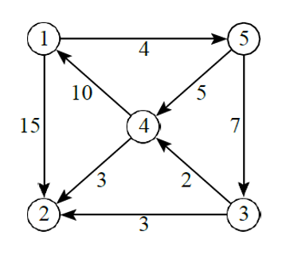
Dijkstra Algorithm
Example:
Find the shortest Paths between the vertex 1 and all the other vertices.

Slide 12
Dijkstra Algorithm
Example:
Initialization
Dist=(0,∞, ∞, ∞, ∞, ∞)
P=(Null, Null, Null, Null, Null)
Q={1,2,3,4,5}
S={}
0
∞
4
1
5
10
4
5
7
15
3
∞
2
2
3
3
∞
∞

Slide 13
Dijkstra Algorithm
Example:
Iteration 1
From Q we choose v=1 (dist(1)=0);
Q={2,3,4,5}
S={1}
Neighbors of 1 from Q are 2 and 5:
Dist(2)= min(∞, dist(1)+w(1,2))
= min (∞, 15)=15
P(2)=1
Dist(5) )= min(∞, dist(1)+w(1,5))
= min (∞, 4)=4
P(5)=1
Dist= (0, 15, 11, ∞, 4)
P=(Null, 1, Null, Null, 1)
4
0
∞
4
1
5
10
4
5
7
15
3
∞
2
2
3
3
∞
∞
15

Slide 14
Dijkstra Algorithm
Example:
Iteration 2
From Q we choose v=5 (dist(5)=4);
Q={2,3,4}
S={1,5}
Neighbors of 5 from Q are 3 and 4:
Dist(3)= min(∞, dist(5)+w(5,3))
= min (∞, 4+7)= min (∞, 11)= 11
P(3)=5
Dist(4) = min(∞, dist(5)+w(5,4))
= min (∞, 4+5)= min (∞, 9)= 9
P(4)=5
Dist= (0, 15, 11, 9, 4)
P=(Null, 1, 5, 5, 1)
0
4
4
1
5
10
4
5
7
15
3
∞
2
9
2
3
3
15
∞
11

Slide 15
Dijkstra Algorithm
Example:
Iteration 3
From Q we choose v=4 (dist(4)=9);
Q={2,3}
S={1,5,4}
Neighbors of 4 from Q is 2:
Dist(2)= min(15, dist(4)+w(4,2))
= min (15, 9+3)= min (15, 12)= 12
P(2)=4
Dist= (0, 12, 11, 9, 4)
P=(Null, 4, 5, 5, 1)
0
4
4
1
5
10
4
5
7
15
3
9
2
2
3
3
15
11
12

Slide 16
Dijkstra Algorithm
Example:
Iteration 4
From Q we choose v=3 (dist(3)=11);
Q={2}
S={1,5,4,3}
Neighbors of 3 from Q is 2:
Dist(2)= min(12, dist(3)+w(3,2))
= min (12, 11+3)= min (12, 14)= 12
Dist= (0, 12, 11, 9, 4)
P=(Null, 4, 5, 5, 1)
0
4
4
1
5
10
4
5
7
15
3
9
2
2
3
3
12
11

Slide 17
Dijkstra Algorithm
Example:
Iteration 5
From Q we choose v=2 (dist(3)=12);
Q={}
S={1,5,4,3,2}
Q is empty => End
Dist= (0, 12, 11, 9, 4)
P=(Null, 4, 5, 5, 1)
0
4
4
4
1
1
5
5
5
10
5
10
4
4
7
15
7
15
3
9
3
2
2
2
2
3
3
3
3
12
11

Slide 18
Dijkstra Algorithm
Exercise 1:
Find the shortest path from 3 to all the others vertices.

Slide 19
Dijkstra Algorithm
Initialization
Dist=(∞,∞, 0, ∞, ∞, ∞)
P=(Null, Null, Null, Null, Null)
Q={1,2,3,4,5}
S={}
∞
∞
4
1
5
10
4
5
7
15
3
∞
2
2
3
3
∞
0

Slide 20
Dijkstra Algorithm
Example:
Iteration 1
From Q we choose v=3 (dist(3)=0);
Q={1,2,4,5}
S={3}
Neighbors of 3 from Q are 2 and 4:
Dist(2)= min(∞, dist(3)+w(3,2))
= min (∞, 3)=3
P(2)=3
Dist(4) = min(∞, dist(3)+w(3,4))
= min (∞, 2)=2
P(4)=3
Dist= (∞, 3, 0, 2, ∞)
P=(Null, 3, Null, 3, 1)
∞
∞
4
1
5
10
4
5
7
15
3
∞
2
2
2
3
3
∞
0
3

Slide 21
Dijkstra Algorithm
Iteration 2
From Q we choose v=4 (dist(4)=2);
Q={1,2,5}
S={3,4}
Neighbors of 4 from Q are 1 and 2:
Dist(1)= min(∞, dist(4)+w(4,1))
= min (∞, 2+10)= min (∞, 12)= 12
P(1)=4
Dist(2) = min(3, dist(4)+w(4,2))
= min (3, 2+3)= min (3, 5)= 3
P(2)=3
Dist= (12, 3, 0, 2, ∞)
P=(4, 3, Null, 3, Null)
12
∞
∞
4
1
5
10
4
5
7
15
3
∞
2
2
2
3
3
∞
0
3

Slide 22
Dijkstra Algorithm
Example:
Iteration 3
From Q we choose v=2 (dist(2)=3);
Q={1,5}
S={3,4,2}
2 has no Neighbor
Dist= (12, 3, 0, 2, ∞)
P=(4, 3, Null, 3, Null)
12
∞
∞
4
1
5
10
4
5
7
15
3
∞
2
2
2
3
3
∞
0
3

Slide 23
Dijkstra Algorithm
Example:
Iteration 4
From Q we choose v=1 (dist(1)=12);
Q={5}
S={3,4,2,1}
Neighbors of 1 from Q is 5:
Dist(5)= min(∞, dist(1)+w(1,5))
= min (∞, 12+4)= min (∞, 16)= 16
P(5)=1
Dist= (12, 3, 0, 2, 16)
P=(4, 3, Null, 3, 1)
12
16
∞
∞
4
1
5
10
4
5
7
15
3
∞
2
2
2
3
3
∞
0
3

Slide 24
Dijkstra Algorithm
Example:
Iteration 5
From Q we choose v=5 (dist(5)=16);
Q={}
S={1,5,4,3,2}
Q is empty => End
Dist= (12, 3, 0, 2, 16)
P=(4, 3, Null, 3, 1)
12
16
4
1
5
10
4
5
7
15
3
2
2
2
3
3
3
0

Slide 25
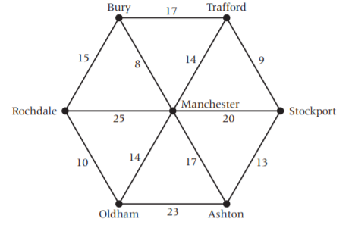
Dijkstra Algorithm
Exercise 2
The diagram below shows roads connecting towns near to Rochdale. The numbers on each arc represent the time, in minutes, required to travel along each road. Peter is delivering books from his base at Rochdale to Stockport. Use Dijkstra’s algorithm to find the minimum time for Peter’s journey.
2
5
4
7
1
6
3

Slide 26
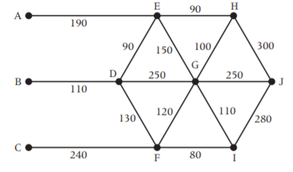
Dijkstra Algorithm
Exercise 3
Three boys walk to school, J, from their homes at A, B and C. The diagram shows the network of roads near their homes and school. The numbers on each arc represent the distance, in metres, along each road. Find which boy lives nearest to the school.

Slide 27
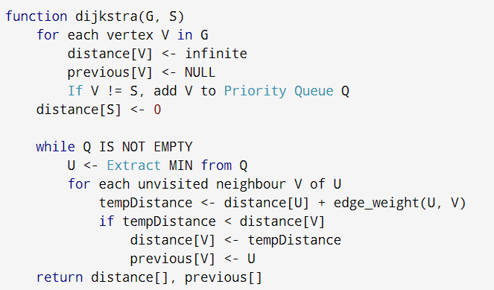
Dijkstra Algorithm
Pseudocode

Slide 28
Bellman-Ford Algorithm
Bellman Ford algorithm helps us find the shortest path from a vertex to all other vertices of a weighted graph. It is similar to Dijkstra's algorithm but it can work with graphs in which edges can have negative weights.

Slide 29
Bellman-Ford Algorithm
Why would one ever have edges with negative weights in real life?
Negative weight edges might seem useless at first but they can explain a lot of phenomena like cashflow, heat released/absorbed in a chemical reaction etc.
For instance, if there are different ways to reach from one chemical A to another chemical B, each method will have sub-reactions involving both heat dissipation and absorption.
If we want to find the set of reactions where minimum energy is required, then we will need to be able to factor in the heat absorption as negative weights and heat dissipation as positive weights.

Slide 30
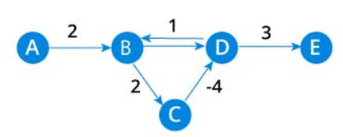
Bellman-Ford Algorithm
Why we need to be careful with negative weights?
Negative weight edges can create negative weight cycles i.e. a cycle which will reduce the total path distance by coming back to the same point.

Slide 31
Bellman-Ford Algorithm
Bellman Ford algorithm works by overestimating the length of the path from the starting vertex to all other vertices. Then it iteratively relaxes those estimates by finding new paths that are shorter than the previously overestimated paths.
By doing this repeatedly for all vertices, we are able to guarantee that the end result is optimized.

Slide 32
Bellman-Ford Algorithm
Bellman Ford pseudocode
We need to maintain the path distance of every vertex. We can store that in an array of size v, where v is the number of vertices.
We also want to able to get the shortest path, not only know the length of the shortest path. For this, we map each vertex to the vertex that last updated its path length.
Once the algorithm is over, we can backtrack from the destination vertex to the source vertex to find the path.

Slide 33
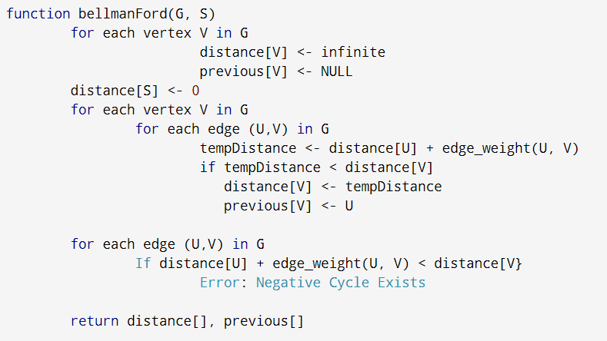
Bellman-Ford Algorithm
Bellman Ford pseudocode

Slide 34
Bellman-Ford Algorithm
Example
We want to find the shortest paths between S and all the others vertices
Initialization
0
8
S
10
∞
E
A
∞
 | S | A | B | C | D | E
Dist | 0 | ∞ | ∞ | ∞ | ∞ | ∞
P | Null | Null | Null | Null | Null | Null
-4
1
1
D
2
∞
B
-1
-2
∞
C
∞

Slide 35
Bellman-Ford Algorithm
Example
We want to find the shortest paths between S and all the others vertices
1st Iteration
0
8
S
10
8
∞
E
∞
A
∞
 | S | A | B | C | D | E
Dist | 0 | ∞ | ∞ | ∞ | ∞ | ∞
P | Null | Null | Null | Null | Null | Null
-4
10
1
1
D
2
∞
B
-1
-2
∞
C
∞

Slide 36
Bellman-Ford Algorithm
Example
We want to find the shortest paths between S and all the others vertices
1st Iteration
0
8
S
10
8
∞
E
∞
A
∞
 | S | A | B | C | D | E
Dist | 0 | 10 | ∞ | ∞ | ∞ | 8
P | Null | S | Null | Null | Null | S
-4
10
1
1
D
2
∞
B
-1
-2
∞
C
∞

Slide 37
Bellman-Ford Algorithm
Example
We want to find the shortest paths between S and all the others vertices
1st Iteration
0
8
S
10
8
∞
E
∞
A
∞
 | S | A | B | C | D | E
Dist | 0 | 10 | ∞ | ∞ | ∞ | 8
P | Null | S | Null | Null | Null | S
-4
10
1
1
D
2
∞
B
-1
-2
∞
C
∞
12

Slide 38
Bellman-Ford Algorithm
Example
We want to find the shortest paths between S and all the others vertices
1st Iteration
0
8
S
10
8
∞
E
∞
A
∞
 | S | A | B | C | D | E
Dist | 0 | 10 | ∞ | 12 | ∞ | 8
P | Null | S | Null | A | Null | S
-4
10
1
1
D
2
∞
B
-1
-2
∞
C
∞
12

Slide 39
Bellman-Ford Algorithm
Example
We want to find the shortest paths between S and all the others vertices
1st Iteration
0
8
S
10
8
∞
E
∞
A
∞
 | S | A | B | C | D | E
Dist | 0 | 10 | ∞ | 12 | ∞ | 8
P | Null | S | Null | A | Null | S
-4
10
1
1
D
2
∞
B
-1
-2
∞
C
∞
12

Slide 40
Bellman-Ford Algorithm
Example
We want to find the shortest paths between S and all the others vertices
1st Iteration
0
8
S
10
8
∞
E
∞
A
∞
 | S | A | B | C | D | E
Dist | 0 | 10 | ∞ | 12 | ∞ | 8
P | Null | S | Null | A | Null | S
-4
10
1
1
D
2
∞
B
-1
-2
∞
C
10
∞
12

Slide 41
Bellman-Ford Algorithm
Example
We want to find the shortest paths between S and all the others vertices
1st Iteration
0
8
S
10
8
∞
E
∞
A
∞
 | S | A | B | C | D | E
Dist | 0 | 10 | 10 | 12 | ∞ | 8
P | Null | S | C | A | Null | S
-4
10
1
1
D
2
∞
B
-1
-2
∞
C
10
∞
12

Slide 42
Bellman-Ford Algorithm
Example
We want to find the shortest paths between S and all the others vertices
1st Iteration
0
8
S
10
8
∞
E
∞
A
∞
 | S | A | B | C | D | E
Dist | 0 | 10 | 10 | 12 | ∞ | 8
P | Null | S | C | A | Null | S
-4
10
1
1
D
2
∞
B
-1
-2
∞
C
10
∞
12

Slide 43
Bellman-Ford Algorithm
Example
We want to find the shortest paths between S and all the others vertices
1st Iteration
0
8
S
10
8
∞
E
∞
A
∞
 | S | A | B | C | D | E
Dist | 0 | 10 | 10 | 12 | ∞ | 8
P | Null | S | C | A | Null | S
-4
10
1
1
D
2
∞
B
9
-1
-2
∞
10
∞
12

Slide 44
Bellman-Ford Algorithm
Example
We want to find the shortest paths between S and all the others vertices
1st Iteration
0
8
S
10
8
∞
E
∞
A
∞
 | S | A | B | C | D | E
Dist | 0 | 10 | 10 | 12 | 9 | 8
P | Null | S | C | A | E | S
-4
10
1
1
D
2
∞
B
9
-1
-2
∞
C
10
∞
12

Slide 45
Bellman-Ford Algorithm
Example
We want to find the shortest paths between S and all the others vertices
2nd Iteration
0
8
S
10
8
E
A
10
 | S | A | B | C | D | E
Dist | 0 | 10 | 10 | 12 | 9 | 8
P | Null | S | C | A | E | S
-4
1
1
D
2
9
B
-1
-2
10
C
12

Slide 46
Bellman-Ford Algorithm
Example
We want to find the shortest paths between S and all the others vertices
2nd Iteration
0
8
S
10
8
E
A
10
 | S | A | B | C | D | E
Dist | 0 | 10 | 10 | 12 | 9 | 8
P | Null | S | C | A | E | S
-4
1
1
D
2
9
B
-1
-2
10
C
12

Slide 47
Bellman-Ford Algorithm
Example
We want to find the shortest paths between S and all the others vertices
2nd Iteration
0
8
S
10
8
E
A
10
 | S | A | B | C | D | E
Dist | 0 | 10 | 10 | 12 | 9 | 8
P | Null | S | C | A | E | S
-4
1
1
D
2
9
B
-1
-2
10
C
12

Slide 48
Bellman-Ford Algorithm
Example
We want to find the shortest paths between S and all the others vertices
2nd Iteration
0
8
S
10
8
E
A
10
 | S | A | B | C | D | E
Dist | 0 | 10 | 10 | 12 | 9 | 8
P | Null | S | C | A | E | S
-4
1
1
D
2
9
B
-1
-2
10
C
12

Slide 49
Bellman-Ford Algorithm
Example
We want to find the shortest paths between S and all the others vertices
2nd Iteration
0
8
S
10
8
E
A
10
 | S | A | B | C | D | E
Dist | 0 | 10 | 10 | 12 | 9 | 8
P | Null | S | C | A | E | S
-4
1
1
D
2
9
B
-1
-2
10
C
12

Slide 50
Bellman-Ford Algorithm
Example
We want to find the shortest paths between S and all the others vertices
2nd Iteration
0
8
S
10
8
E
A
10
 | S | A | B | C | D | E
Dist | 0 | 10 | 10 | 12 | 9 | 8
P | Null | S | C | A | E | S
-4
1
1
D
2
9
B
-1
-2
10
C
12

Slide 51
Bellman-Ford Algorithm
Example
We want to find the shortest paths between S and all the others vertices
2nd Iteration
0
8
S
10
8
E
A
10
 | S | A | B | C | D | E
Dist | 0 | 10 | 10 | 12 | 9 | 8
P | Null | S | C | A | E | S
-4
1
1
D
2
9
B
-1
-2
10
C
12

Slide 52
Bellman-Ford Algorithm
Example
We want to find the shortest paths between S and all the others vertices
2nd Iteration
0
8
S
10
8
E
A
10
 | S | A | B | C | D | E
Dist | 0 | 10 | 10 | 12 | 9 | 8
P | Null | S | C | A | E | S
-4
1
1
D
2
9
B
-1
-2
10
C
12

Slide 53
Bellman-Ford Algorithm
Example
We want to find the shortest paths between S and all the others vertices
2nd Iteration
0
8
S
10
8
E
A
10
 | S | A | B | C | D | E
Dist | 0 | 10 | 10 | 12 | 9 | 8
P | Null | S | C | A | E | S
-4
5
1
1
D
2
9
B
-1
-2
10
C
12
8

Slide 54
Bellman-Ford Algorithm
Example
We want to find the shortest paths between S and all the others vertices
2nd Iteration
0
8
S
10
8
E
A
10
 | S | A | B | C | D | E
Dist | 0 | 5 | 10 | 8 | 9 | 8
P | Null | D | C | D | E | S
-4
5
1
1
D
2
9
B
-1
-2
10
C
12
8

Slide 55
Bellman-Ford Algorithm
Example
We want to find the shortest paths between S and all the others vertices
2nd Iteration
0
8
S
10
8
E
A
10
 | S | A | B | C | D | E
Dist | 0 | 5 | 10 | 8 | 9 | 8
P | Null | D | C | D | E | S
-4
5
1
1
D
2
9
B
-1
-2
10
C
12
8

Slide 56
Bellman-Ford Algorithm
Example
We want to find the shortest paths between S and all the others vertices
2nd Iteration
0
8
S
10
8
E
A
10
 | S | A | B | C | D | E
Dist | 0 | 5 | 10 | 8 | 9 | 8
P | Null | D | C | D | E | S
-4
5
1
1
D
2
9
B
-1
-2
10
C
12
8

Slide 57
Bellman-Ford Algorithm
Example
We want to find the shortest paths between S and all the others vertices
3rd Iteration
0
8
S
10
8
E
A
5
 | S | A | B | C | D | E
Dist | 0 | 5 | 10 | 8 | 9 | 8
P | Null | D | C | D | E | S
-4
1
1
D
2
9
B
-1
-2
10
C
8

Slide 58
Bellman-Ford Algorithm
Example
We want to find the shortest paths between S and all the others vertices
3rd Iteration
0
8
S
10
8
E
A
5
 | S | A | B | C | D | E
Dist | 0 | 5 | 10 | 8 | 9 | 8
P | Null | D | C | D | E | S
-4
1
1
D
2
9
B
-1
-2
10
C
8
7

Slide 59
Bellman-Ford Algorithm
Example
We want to find the shortest paths between S and all the others vertices
3rd Iteration
0
8
S
10
8
E
A
5
 | S | A | B | C | D | E
Dist | 0 | 5 | 10 | 7 | 9 | 8
P | Null | D | C | A | E | S
-4
1
1
D
2
9
B
-1
-2
10
C
8
7

Slide 60
Bellman-Ford Algorithm
Example
We want to find the shortest paths between S and all the others vertices
3rd Iteration
0
8
S
10
8
E
A
5
 | S | A | B | C | D | E
Dist | 0 | 5 | 10 | 7 | 9 | 8
P | Null | D | C | A | E | S
-4
1
1
D
2
9
B
-1
-2
10
C
8
7

Slide 61
Bellman-Ford Algorithm
Example
We want to find the shortest paths between S and all the others vertices
3rd Iteration
0
8
S
10
8
E
A
5
 | S | A | B | C | D | E
Dist | 0 | 5 | 10 | 7 | 9 | 8
P | Null | D | C | A | E | S
-4
1
1
D
2
9
B
-1
-2
10
C
5
8
7

Slide 62
Bellman-Ford Algorithm
Example
We want to find the shortest paths between S and all the others vertices
3rd Iteration
0
8
S
10
8
E
A
5
 | S | A | B | C | D | E
Dist | 0 | 5 | 5 | 7 | 9 | 8
P | Null | D | C | A | E | S
-4
1
1
D
2
9
B
-1
-2
10
C
5
8
7

Slide 63
Bellman-Ford Algorithm
Example
We want to find the shortest paths between S and all the others vertices
3rd Iteration
0
8
S
10
8
E
A
5
 | S | A | B | C | D | E
Dist | 0 | 5 | 5 | 7 | 9 | 8
P | Null | D | C | A | E | S
-4
1
1
D
2
9
B
-1
-2
10
C
5
8
7

Slide 64
Bellman-Ford Algorithm
Example
We want to find the shortest paths between S and all the others vertices
3rd Iteration
0
8
S
10
8
E
A
5
 | S | A | B | C | D | E
Dist | 0 | 5 | 5 | 7 | 9 | 8
P | Null | D | C | A | E | S
-4
1
1
D
2
9
B
-1
-2
10
C
5
8
7

Slide 65
Bellman-Ford Algorithm
Example
We want to find the shortest paths between S and all the others vertices
4th Iteration
0
8
S
10
8
E
A
5
 | S | A | B | C | D | E
Dist | 0 | 5 | 5 | 7 | 9 | 8
P | Null | D | C | A | E | S
-4
1
1
D
2
9
B
-1
-2
C
5
7

Slide 66
Bellman-Ford Algorithm
Example
We want to find the shortest paths between S and all the others vertices
4th Iteration
0
8
S
10
8
E
A
5
 | S | A | B | C | D | E
Dist | 0 | 5 | 5 | 7 | 9 | 8
P | Null | D | C | A | E | S
-4
1
1
D
2
9
B
-1
-2
C
5
7

Slide 67
Bellman-Ford Algorithm
Example
We want to find the shortest paths between S and all the others vertices
4th Iteration
0
8
S
10
8
E
A
5
 | S | A | B | C | D | E
Dist | 0 | 5 | 5 | 7 | 9 | 8
P | Null | D | C | A | E | S
-4
1
1
D
2
9
B
-1
-2
C
5
7

Slide 68
Bellman-Ford Algorithm
Example
We want to find the shortest paths between S and all the others vertices
4th Iteration
0
8
S
10
8
E
A
5
 | S | A | B | C | D | E
Dist | 0 | 5 | 5 | 7 | 9 | 8
P | Null | D | C | A | E | S
-4
1
1
D
2
9
B
-1
-2
C
5
7

Slide 69
Bellman-Ford Algorithm
Example
We want to find the shortest paths between S and all the others vertices
4th Iteration
0
8
S
10
8
E
A
5
 | S | A | B | C | D | E
Dist | 0 | 5 | 5 | 7 | 9 | 8
P | Null | D | C | A | E | S
-4
1
1
D
2
9
B
-1
-2
C
5
7

Slide 70
Bellman-Ford Algorithm
Example
We want to find the shortest paths between S and all the others vertices
4th Iteration
0
8
S
10
8
E
A
5
 | S | A | B | C | D | E
Dist | 0 | 5 | 5 | 7 | 9 | 8
P | Null | D | C | A | E | S
-4
1
1
D
2
9
B
-1
-2
C
5
7

Slide 71
Bellman-Ford Algorithm
Example
We want to find the shortest paths between S and all the others vertices
4th Iteration
End of the algorithm
0
8
S
10
8
E
A
5
 | S | A | B | C | D | E
Dist | 0 | 5 | 5 | 7 | 9 | 8
P | Null | D | C | A | E | S
-4
1
1
D
2
9
B
-1
-2
C
5
7

Slide 72

Bellman-Ford Algorithm
Example
Finally, we have to check if no negative cycle exists
0
8
S
10
8
E
A
5
-4
1
1
D
2
9
B
-1
-2
C
5
7

Slide 73
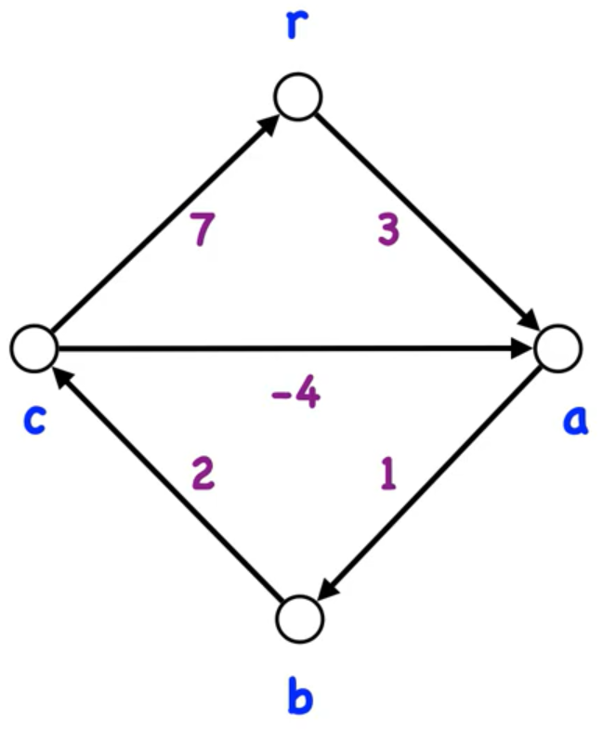
Bellman-Ford Algorithm
Example 2
Find the shortest paths starting from vertex r

Slide 74
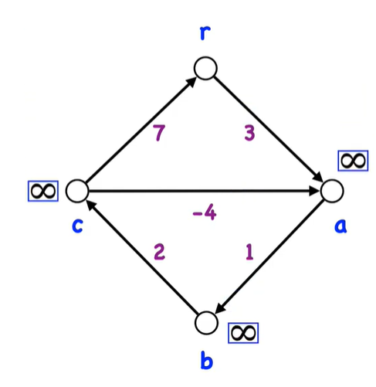
Bellman-Ford Algorithm
Example 2
Find the shortest paths starting from vertex r
Initialization

Slide 75
Bellman-Ford Algorithm
Exercise 1
Find the shortest path between a and all the other vertices
5
b
d
6
-2
a
8
7
-3
-4
7
c
e
9

Slide 76
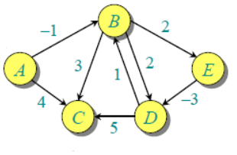
Bellman-Ford Algorithm
Exercise 2
Find the shortest path between A and all the other vertices

